Slide 1


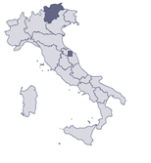
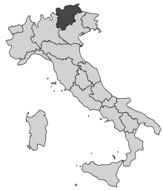
Towards a True Energetically Sustainable WSN: A Case Study with Prediction-Based Data Collection and a Wake-up Receiver
Alessandro Bogliolo, Valerio Freschi, Emanuele Lattanzi, Amy L. Murphy and Usman Raza
Notes:
Energetic Sustainable
Power consumption Model….
Title… and
Simulator evaluation details are missing altogether
Gp’s
- wakeup radio prototypes
- motivate case study with that
No details of 380 and wakeup receiver !!!!!
JUSTIFY!
Define baseline

Slide 2
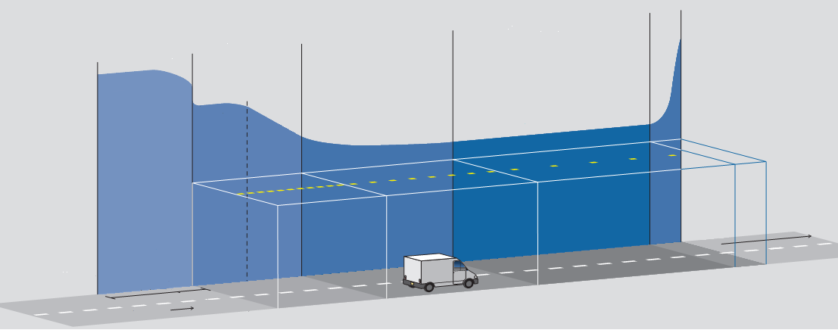


A Motivating Case Study:
Adaptive Lighting with WSNs
Lamp levels typically statically determined, ignoring environmental
  Overprovisioned to meet the regulations
Problems: waste energy and potential security hazard
Idea: place wireless sensors along tunnel, adjust lamps to actual conditions
  Eliminate overprovisioning, account for environmental variations
stop
distance
Notes:
Put it
How it is typically done
Objective: day time, It is not to dark ..
Night not too bright
driver
Statically over provisions the light
Over provisions
Ponte alto and its statistics

Slide 3
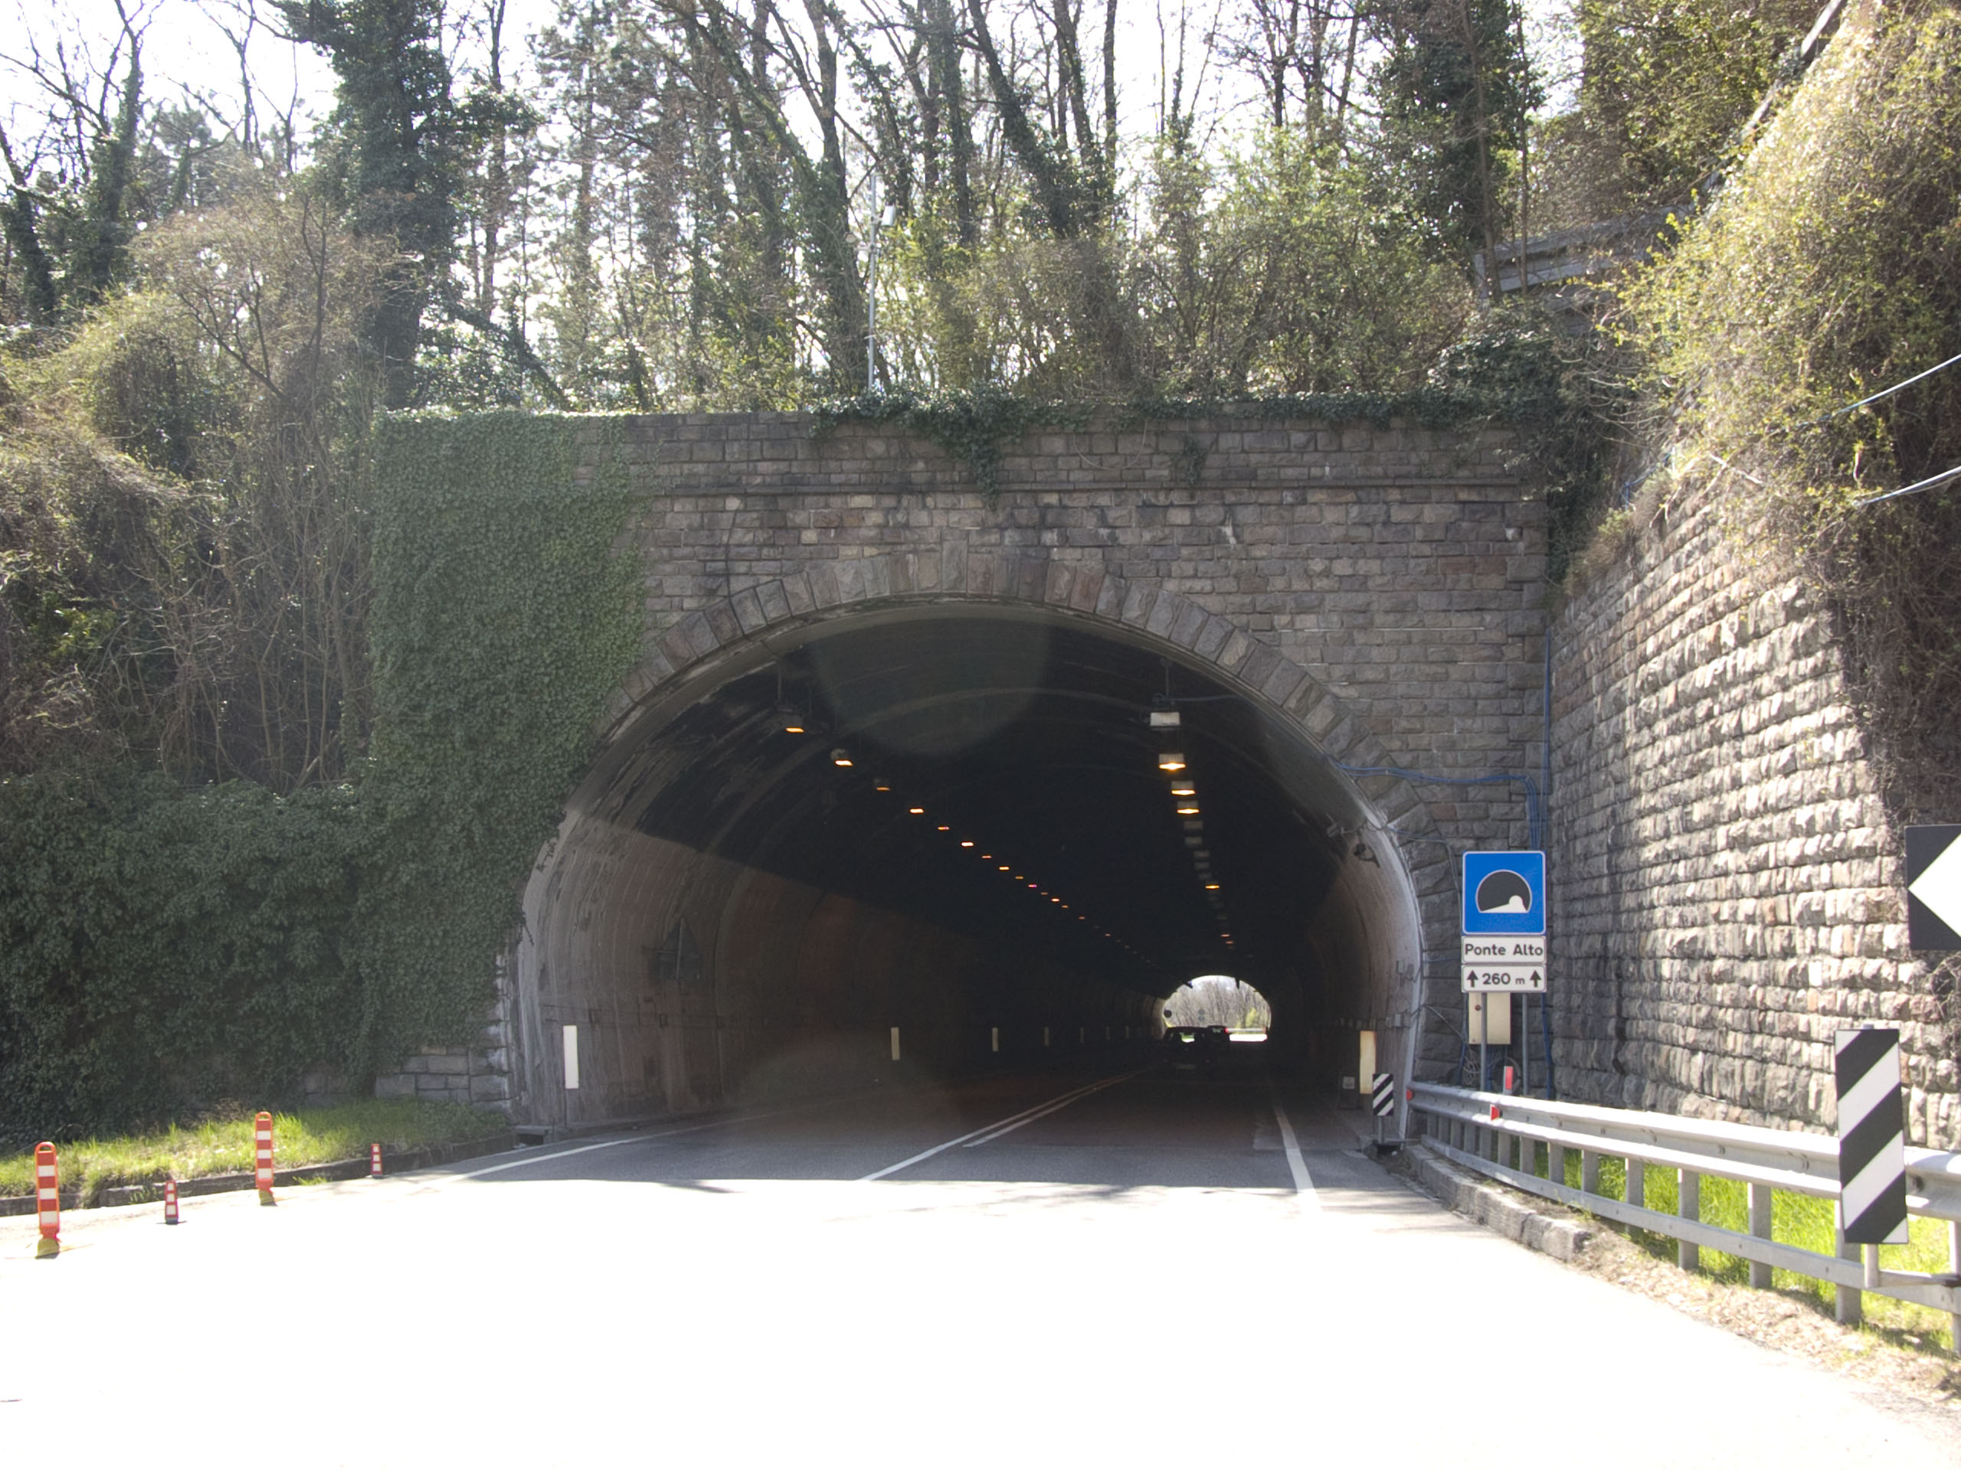
Full, operational system described in IPSN’11
2-lane carriageway
Tunnel length of 260 m,
40 battery powered WSN nodes

Slide 4
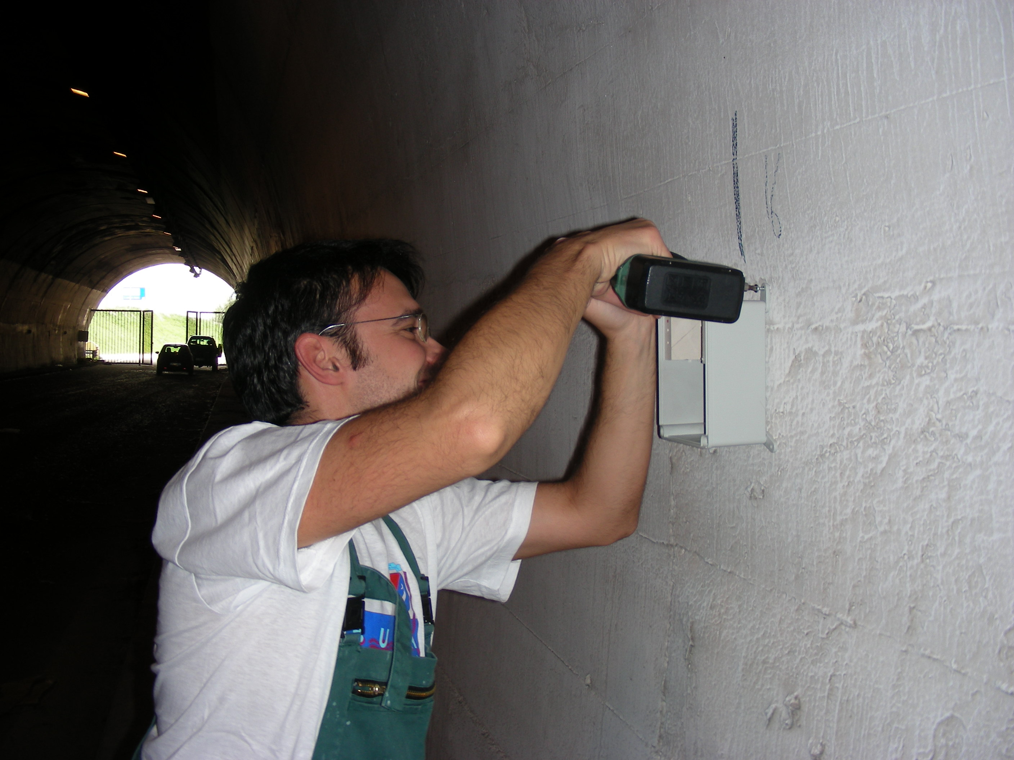
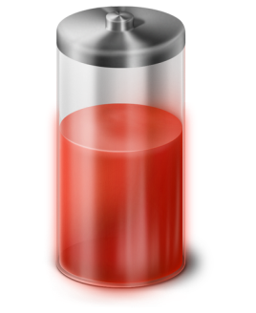


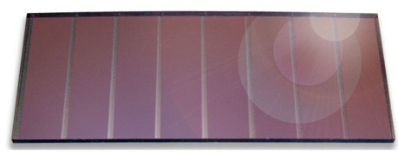
Goal: Using Renewable Energy for Achieving a Long Term Operation
Currently, nodes are powered with disposable batteries
Problem:
  Short lifetime
  Replacement is expensive, labour intensive and a safety hazard
Goal: long term operation with rechargeable batteries and energy harvesters
Lifetime
Notes:
shortnen
Wanna get rid of batteries
Batteries are expensive

Slide 5
Goal: Using Renewable Energy for Achieving a Long Term Operation
Currently, nodes are powered with disposable batteries
Problem:
  Short lifetime
  Replacement is expensive, labour intensive and a safety hazard
Goal: long term operation with rechargeable batteries and energy harvesters
Harvestable energy is two orders of magnitude less than the power consumption
Lifetime
Notes:
Put text

Slide 6
Approach:
A Software Hardware Co-design for Minimizing Energy Consumption
1
Prediction Based Data Collection
Software
2
VirtualSense
3
Harvester
Dynamic Power Management
Wakeup
Receiver
Photovoltaic
Hardware
Notes:
It also defines the layout
Add Sotware hardware labels
Add the numbers

Slide 7
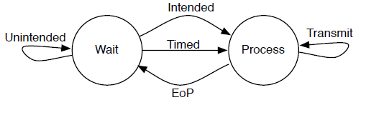
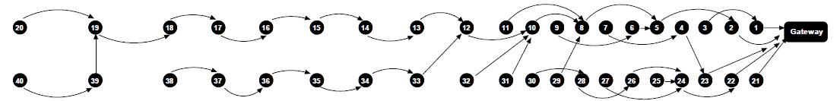
Evaluation Methodology
Model described in ENSSys’13
Power consumption model
  Functional state diagram
  Empirical hardware
  measurements
Network traffic
  Actual data from the tunnel
  47 days, 1 sample every 30s, 5.4 million measurements
Multiple data collection trees
Notes:
Data collection trees bias unfairly
Forwarding
+
Particular wakeup re
Tree

Slide 8
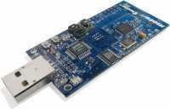
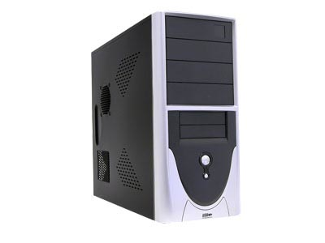
1: Prediction Based
Data Collection
1
Software
VirtualSense
Harvester
DPM
WURx
Photovoltaic
Typical WSN System
Sink gathers all sensor readings of the WSN.
Advantage: precise
Prediction Based Data Collection/ WSNs
Sink predicts sensor readings of the WSN.
Advantage: less traffic
time
Notes:
Exactly same data ------------------→ A lot of DATAAAAAAAAAAAAAAAAAAAAAAAAAAAAAAAAAAAAAA
actual
less
Sink GATHERS
Sink PREDICTS

Slide 9
1: Prediction Based
Data Collection
1
Software
VirtualSense
Harvester
DPM
WURx
Photovoltaic
Derivative Based Prediction (DBP)
  A linear model: Easy to compute
  Excellent data approximation
99% reduction in data traffic
  saves radio communication cost
δ
Sensor value
Time
DBP Model
DBP is described in PerCom’12
Notes:
Congestion
Overhearing
Communication cost
PBDC
DPM – Energy saving
Wakeup receiver: periodic receive checks, transmission times & receptions times

Slide 10
Lifetime Improvement
1
Software
VirtualSense
Harvester
DPM
WURx
Photovoltaic
No. | Dynamic Power Management |  | Wakeup Receiver | Lifetime Improvement
 | MCU | Radio |  | Periodic | DBP
1 | Standby | LPM1 | No | 1x | 1.7x
Standard Hardware
Standard hardware
+ NO software Optimization = Baseline
DBP almost doubles the lifetime
Notes:
What this table is????
Software hw

Slide 11
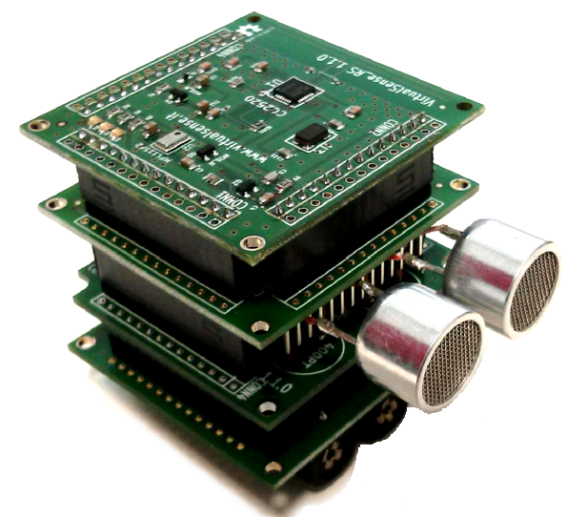
2: VirtualSense
Software
2
VirtualSense
Harvester
DPM
WURx
Photovoltaic
Ultra low power platform
  Ideal for energy harvesting WSNs
Features
  Dynamic power management
  Novel wakeup receiver
VirtualSense Node
Notes:
Focus on next
Treat it as outline

Slide 12





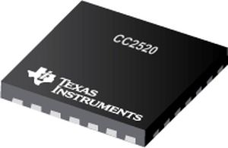
2.1: Dynamic Power
Management (DPM)
Software
2
VirtualSense
Harvester
DPM
WURx
Photovoltaic
Microcontroller: TI MSP430f54xx
  Turn off components between idle periods
  (infrequent transmissions of DBP models)
  Power consumption varies from 0.66nW
  and 10mW
Radio: CC2520 RF Transceiver
  Deep sleep mode (LPM2)
    Infrequent transmissions of DBP models
    Current draw (~0.1 uA) in receive mode
  Frame Filtering
    Allows discarding unintended packets
Notes:
Hints to case study ??
FF: “unicast” unintendedpackets

Slide 13
Lifetime Improvement
1
Software
VirtualSense
Harvester
DPM
WURx
Photovoltaic
No. | Dynamic Power Management |  | Wakeup Receiver | Lifetime Improvement
 | MCU | Radio |  | Periodic | DBP
1 | Standby | LPM1 | No | 1x | 1.7x
Standard Hardware

Slide 14
Lifetime Improvement
Software
2
VirtualSense
Harvester
DPM
WURx
Photovoltaic
No. | Dynamic Power Management |  | Wakeup Receiver | Lifetime Improvement
 | MCU | Radio |  | Periodic | DBP
1 | Standby | LPM1 | No | 1x | 1.7x
2 | Standby | LPM2 | No | 1.7x | 7.8x
3 | Standby | LPM2+FF | No | 2x | 7.8x
4 | Sleep | LPM2 | No | 1.7x | 7.9x
5 | Sleep | LPM2+FF | No | 2.0x | 7.9x
Improvement not two orders of magnitude: Not energetically sustainable !!!
Multiple DPM configurations
Notes:
Not energetically
Did a lot got little
Radical

Slide 15
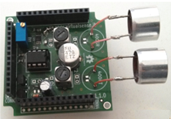
2.2: Wakeup Receiver
Software
2
VirtualSense
Harvester
DPM
WURx
Photovoltaic
Uses ultra sound technology
Out of band triggering
  turns ON expensive data transceiver only for data receptions.
Ultra-low energy consumption
  Rx: 820nA vs. 18.5mA for primary data radio
Range 14m
Ultrasound Wakeup Receiver
Notes:
Could not find comparable numbers

Slide 16
2.2: Wakeup Receiver
Software
2
VirtualSense
Harvester
DPM
WURx
Photovoltaic
Dominant receive checks
Tx
Sender
Without
Receiver
Rx
Wakeup receiver ON
Shorter
Tx
With
Sender
Rx
Receiver
Trigger
Energy Efficiency: No receive checks and shorter Tx
Notes:
Add Animation
Border
Too much blue
Fix it visually
awefull

Slide 17
Lifetime Improvement
Software
2
VirtualSense
Harvester
DPM
WURx
Photovoltaic
No. | Dynamic Power Management |  | Wakeup Receiver | Lifetime Improvement
 | MCU | Radio |  | Periodic | DBP
1 | Standby | LPM1 | No | 1x | 1.7x
2 | Standby | LPM2 | No | 1.7x | 7.8x
3 | Standby | LPM2+FF | No | 2x | 7.8x
4 | Sleep | LPM2 | No | 1.7x | 7.9x
5 | Sleep | LPM2+FF | No | 2.0x | 7.9x

Slide 18
Lifetime Improvement
Software
2
VirtualSense
Harvester
DPM
WURx
Photovoltaic
No. | Dynamic Power Management |  | Wakeup Receiver | Lifetime Improvement
 | MCU | Radio |  | Periodic | DBP
1 | Standby | LPM1 | No | 1x | 1.7x
2 | Standby | LPM2 | No | 1.7x | 7.8x
3 | Standby | LPM2+FF | No | 2x | 7.8x
4 | Sleep | LPM2 | No | 1.7x | 7.9x
5 | Sleep | LPM2+FF | No | 2.0x | 7.9x
6 | Sleep | LPM2 | Yes | 2.6x
+ Wakeup Receiver
Modest improvement- huge traffic
Notes:
A lot of traffic tx + fws →2.6 eliminating benefit

Slide 19
Lifetime Improvement
Software
2
VirtualSense
Harvester
DPM
WURx
Photovoltaic
No. | Dynamic Power Management |  | Wakeup Receiver | Lifetime Improvement
 | MCU | Radio |  | Periodic | DBP
1 | Standby | LPM1 | No | 1x | 1.7x
2 | Standby | LPM2 | No | 1.7x | 7.8x
3 | Standby | LPM2+FF | No | 2x | 7.8x
4 | Sleep | LPM2 | No | 1.7x | 7.9x
5 | Sleep | LPM2+FF | No | 2.0x | 7.9x
6 | Sleep | LPM2 | Yes | 2.6x | 380x
Two order of magnitude improvement with DBP + wakeup reeciver
+ Wakeup Receiver

Slide 20
3: Harvester –
Energetic Sustainability?
Software
VirtualSense
3
Harvester
DPM
WURx
Photovoltaic
Harvested

Slide 21


3: Harvester –
Energetic Sustainability?
Software
VirtualSense
3
Harvester
DPM
WURx
Photovoltaic
Harvested

Slide 22
3: Harvester –
Energetic Sustainability?
Software
VirtualSense
3
Harvester
DPM
WURx
Photovoltaic
Not energetically sustainable
Harvested
Hardware

Slide 23
3: Harvester –
Energetic Sustainability?
Software
VirtualSense
3
Harvester
DPM
WURx
Photovoltaic
Harvested
Hardware
Hardware+Software
Energetically sustainable even for nodes with least harvestable energy

Slide 24
Conclusion
Prediction Based Data Collection
VirtualSense
Harvester
Dynamic Power Management
Wakeup
Receiver
Photovoltaic
Lifetime
Notes:
It also defines the layout
Add Sotware hardware labels
Add the numbers

Slide 25
Conclusion
This is only the beginning…
  Short range of wakeup receiver: dense deployment
  Directional wakeup receiver: fixed tree/ robustness?
  Analytical model is promising, real node evaluation is needed
Even though it is a case study, results are potentially wide
  DBP is generally applicable to WSNs
  Tunnel = data collection, common in most WSNs
  VirtualSense hardware is modular: expandable
Not to forget, we got excellent results!
  380 x improvement → ∞ lifetime

Slide 26
Thank you raza@fbk.eu

Slide 27
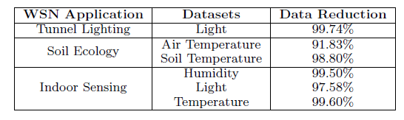
Data reduction with DBP

